Slide 1
V.E. Day Tasks
Thursday 7th May 2020

Slide 2
We hope you enjoy choosing and completing some of these tasks. We are all very sorry to not be celebrating together in our planned Polwhele House Street Party.
Please email your form tutor or teacher photos of what you do. We love seeing and sharing your work and creations.
Mrs Mann, Mrs Topsey-Eaton, Miss Topsey, Mrs Spoors, Mrs Spencer, Mr Kellas, Mrs Mckeown and Mrs Virr.

Slide 3
MAKE IT… Great British Bunting Challenge | PLAN IT… Plan a Street Party using your Maths skills | BAKE IT… Bake a cake and decorate it with VE Day related colours to celebrate.
SING IT… Learn a song from the 1940s | DANCE IT… Learn to dance the Lindy Bop | WRITE IT… Write an acrostic poem – Victory in Europe
COMMUNICATE IT… Write a radio broadcast telling the world it is time to celebrate | CREATE IT… Design and create a medal | EXPRESS IT… Write a bunting poem about celebrating VE Day
SOLVE IT… Complete the Codebreaker Task | PLAY IT… Learn to play Draughts or Backgammon | CODE IT… Make a Codebreaker

Slide 4
MAKE IT…
Great British Bunting Challenge
On Friday 8 May 2020 Britain will be commemorating the 75th anniversary of VE Day when the guns fell silent at the end of war in Europe.
Due to the coronavirus restrictions most VE Day 75 events and street parties have had to be cancelled or postponed but we still want you to be able to mark the occasion, share your pride in our country and honour the men and women of WW2.
You can make your own special VE Day 75 ‘Great British Bunting’ to display in your window at home.
Press find out more for the instructions you need to get started using any paper, cereal boxes, string, ribbon, sweet wrappers, felt pens, poster paint you have or whatever you can find.
You can decorate your bunting with pictures of whatever inspires you, whether it’s those who fought on the frontline or worked hard on the Homefront, or whether it’s a celebration of enduring peace or your own personal hero.
Hang your bunting with pride over the weekend of Friday 8 May - Sunday 10 May and make sure you share your pictures with us and on social media using the hashtags #GreatBritishBunting, #VEDay75 and #BBCMakeaDifference.
https://www.bbc.co.uk/programmes/articles/4TrqYDyf4PMdLypxzyTwGDg/great-british-bunting
HOME

Slide 5
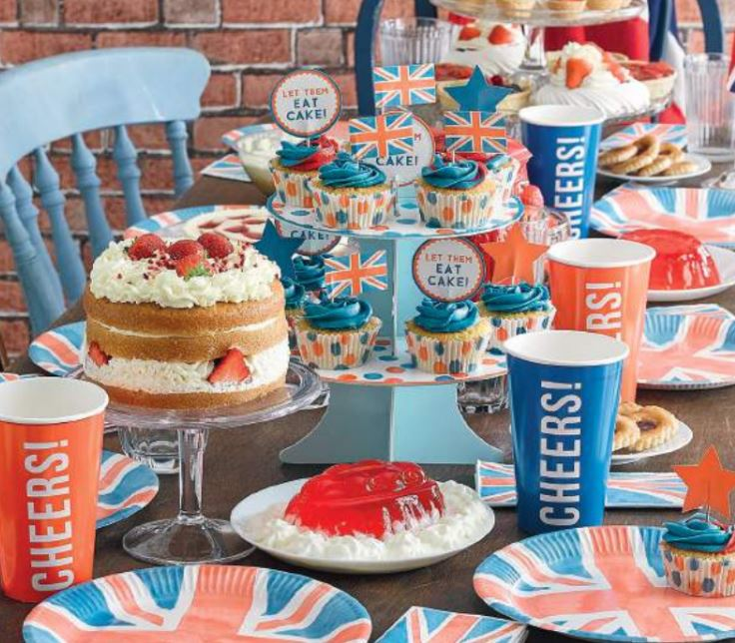
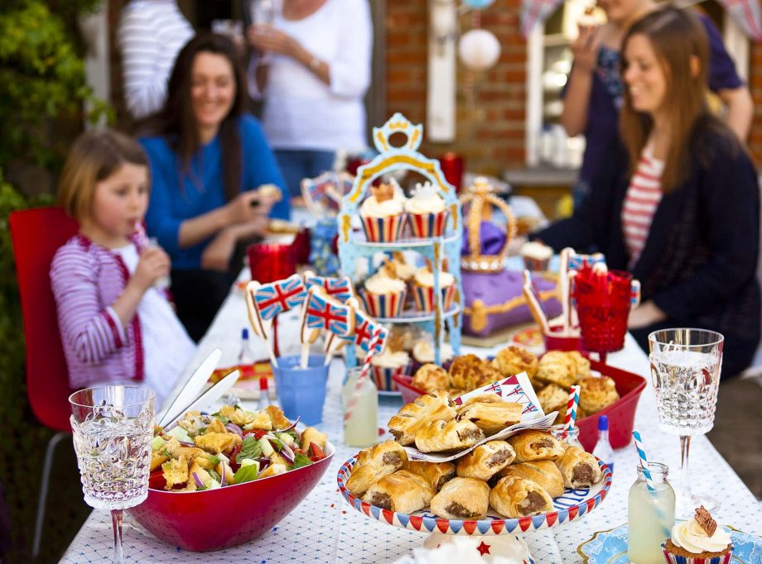
PLAN IT…
Plan a Street Party
KS1: Create a menu for VE Day. What foods
would you use to celebrate this special event?
KS2: Use the VE Party sheets to plan your menu.
Can you figure out how much it will cost?
HOME

Slide 6
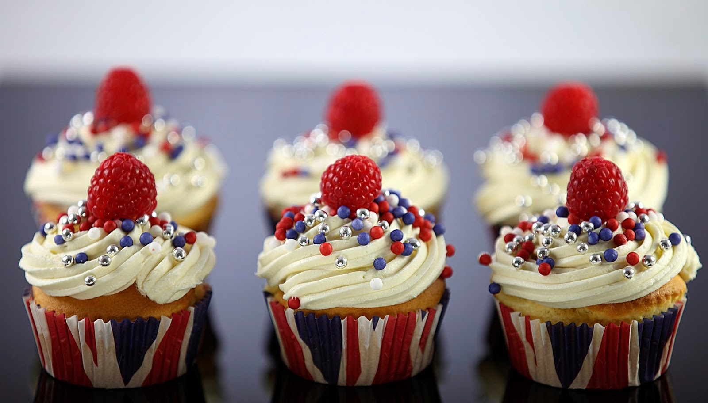
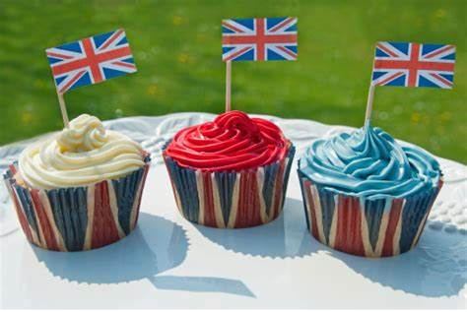
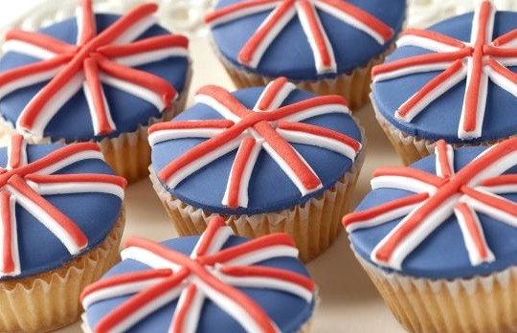
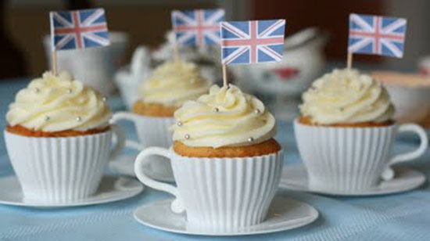
BAKE IT…
Bake a VE Day celebration tea.
VE DAY
Cupcake Recipe
Prep Time: 7 minutes
Cook Time: 18 minutes
Additional Time: 20 minutes
Total Time: 45 minutes
Ingredients
2 large eggs (room temperature)
1 cup granulated sugar
113 grams butter (1/2 cup), room temperature
1 teaspoon vanilla extract
1 1/2 cups all-purpose flour
1 1/2 teaspoons baking powder
pinch of salt
1/2 cup milk
To decorate
Icing sugar
Softened butter
Red / blue Food colouring
Optional – strawberries / blueberries / raspberries
Sprinkles
Instructions
Line a muffin pan with cupcake liners and preheat oven to 350 degrees F.
Using an electric mixer, beat together eggs and granulated sugar. Once combined, add softened butter and vanilla. Mix until creamy.
In a small bowl, sift together flour, baking powder, and salt.
Alternating with the milk, add dry ingredients to egg and sugar mixture in three equal increments. Mix well.
Scoop cupcake batter into the lined muffin pan, filling each cavity about 2/3rds of the way. Bake for 17-20 minutes or until a toothpick comes out clean when poked through the centre.
Remove your tasty, vanilla cupcakes from the oven and let sit for about 2 minutes. Remove each cake from the pan and cool completely on a wire rack.
NOTE: if making mini cupcakes, please reduce the baking time to 12-15 minutes.
You can now Decorate them with Blue, White and Red icing – what designs will you come up with ?
HOME
Find out more…

Slide 7
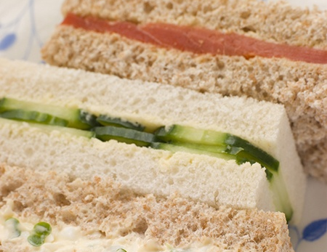
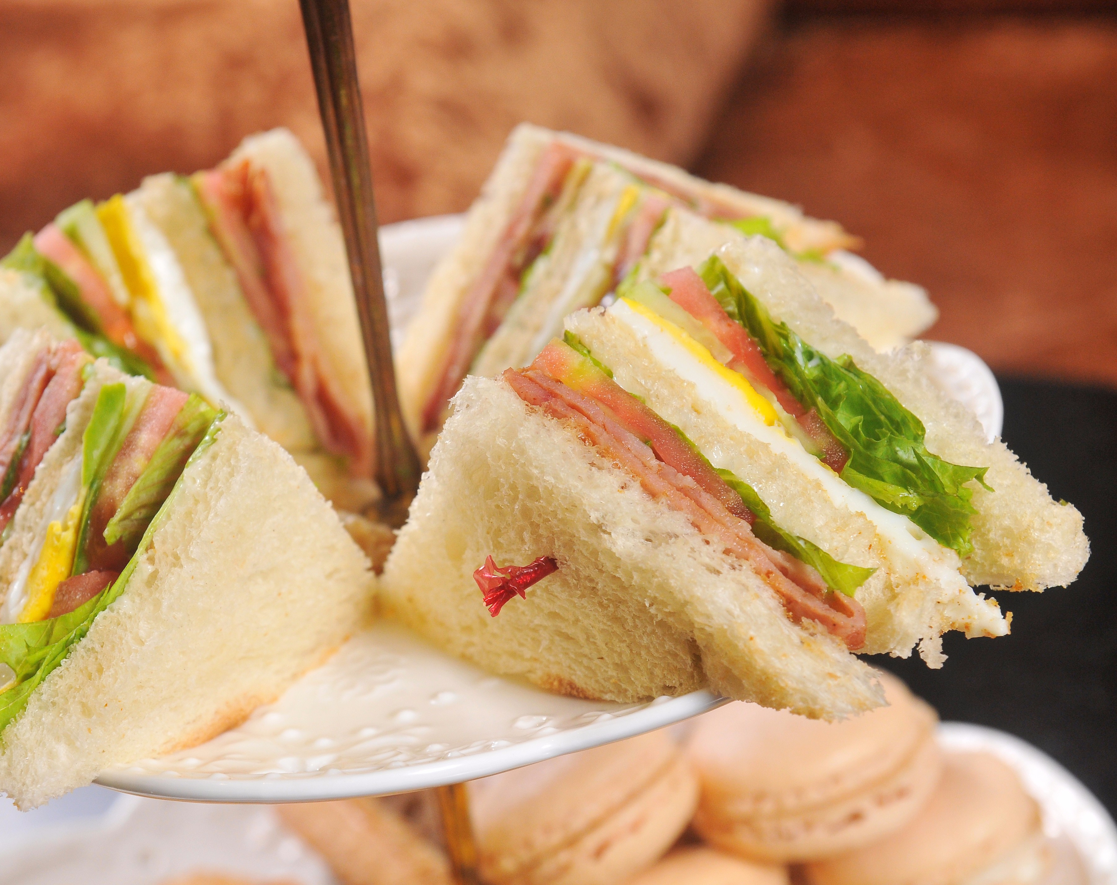
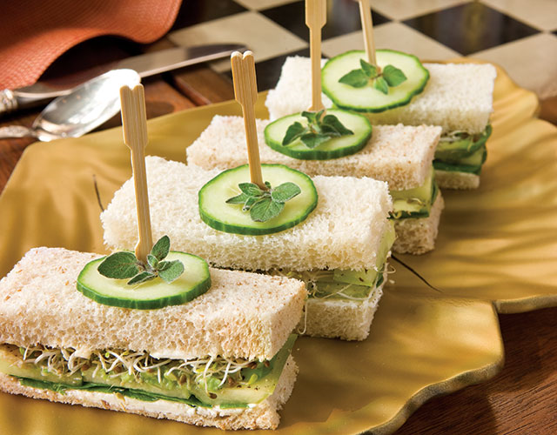
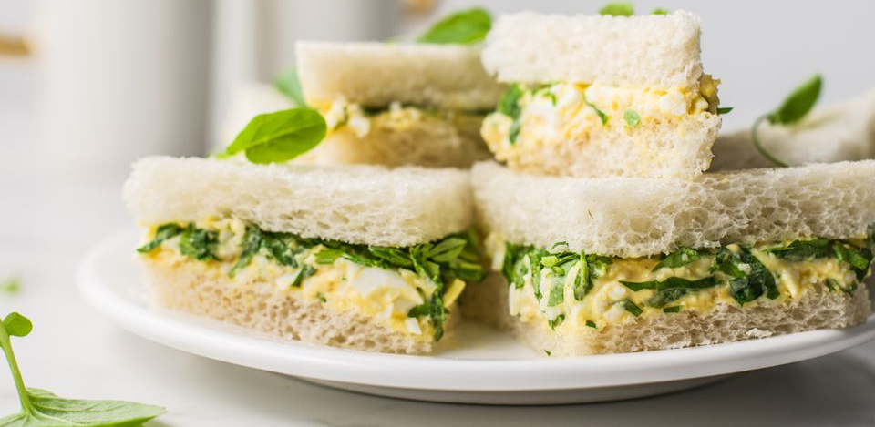
BAKE IT…
Bake a VE Day celebration tea.
Why don’t you make a plate of High Tea sandwiches ?
What flavours will you choose ?
Cucumber and cream cheese
Chopped egg and cress
Corned beef and tomato
Cheese and pickle
HOME
Find out more…

Slide 8
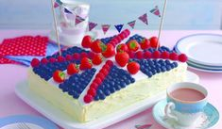
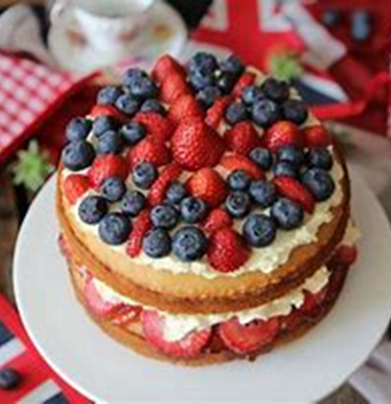
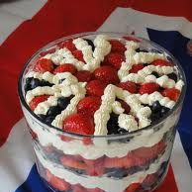
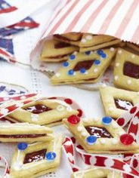
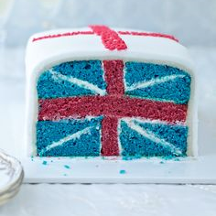
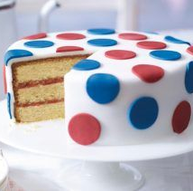
BAKE IT…
Bake a VE Day celebration tea.
What other VE day celebration delights could you create ?
HOME
Find out more…

Slide 9
SING IT…
Learn songs from the period of VE Day
Learn ‘The White Cliffs of Dover’.
Think about the tone it should be sung with and what the lyrics mean.
Record yourself singing it.
HOME
Find out more…

Slide 10
SING IT…
Learn songs from the period of VE Day
(There'll Be Bluebirds Over) The White Cliffs Of Dover
There'll be bluebirds over The white cliffs of Dover, Tomorrow, just you wait and see. I'll never forget the people I met braving those angry skys I remember well as the shadows fell the light of hope in their eyes and though I'm far away I still can hear them say Sun's up for when the dawn comes up
There'll be bluebirds over The white cliffs of Dover, Tomorrow, just you wait and see.
There'll be love and laughter And peace ever after. Tomorrow, when the world is free The shepherd will tend his sheep. The valley will bloom again. And Jimmy will go to sleep In his own little room again. There'll be bluebirds over The white cliffs of Dover, Tomorrow, just you wait and see.
HOME

Slide 11
DANCE IT…
Learn to dance the Lindy Hop
HOME

Slide 12
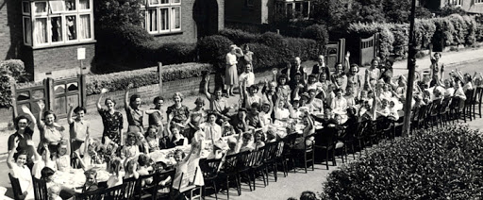
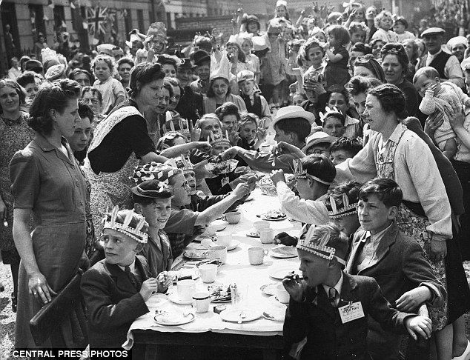
EXPRESS IT…
Write a VE Day celebration poem
Look at the images in the WRITE IT slides. Think about what you feel during this celebration.
Colour and decorate a bunting triangle as a background, then fill it with a poem of celebration to mark the 75th anniversary of the end of WW2. Make is as jubilant as you can!
HOME
Find out more…

Slide 13
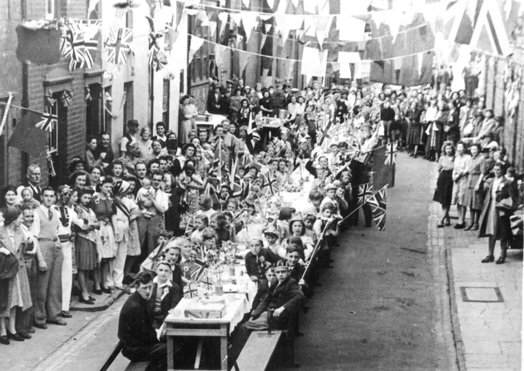
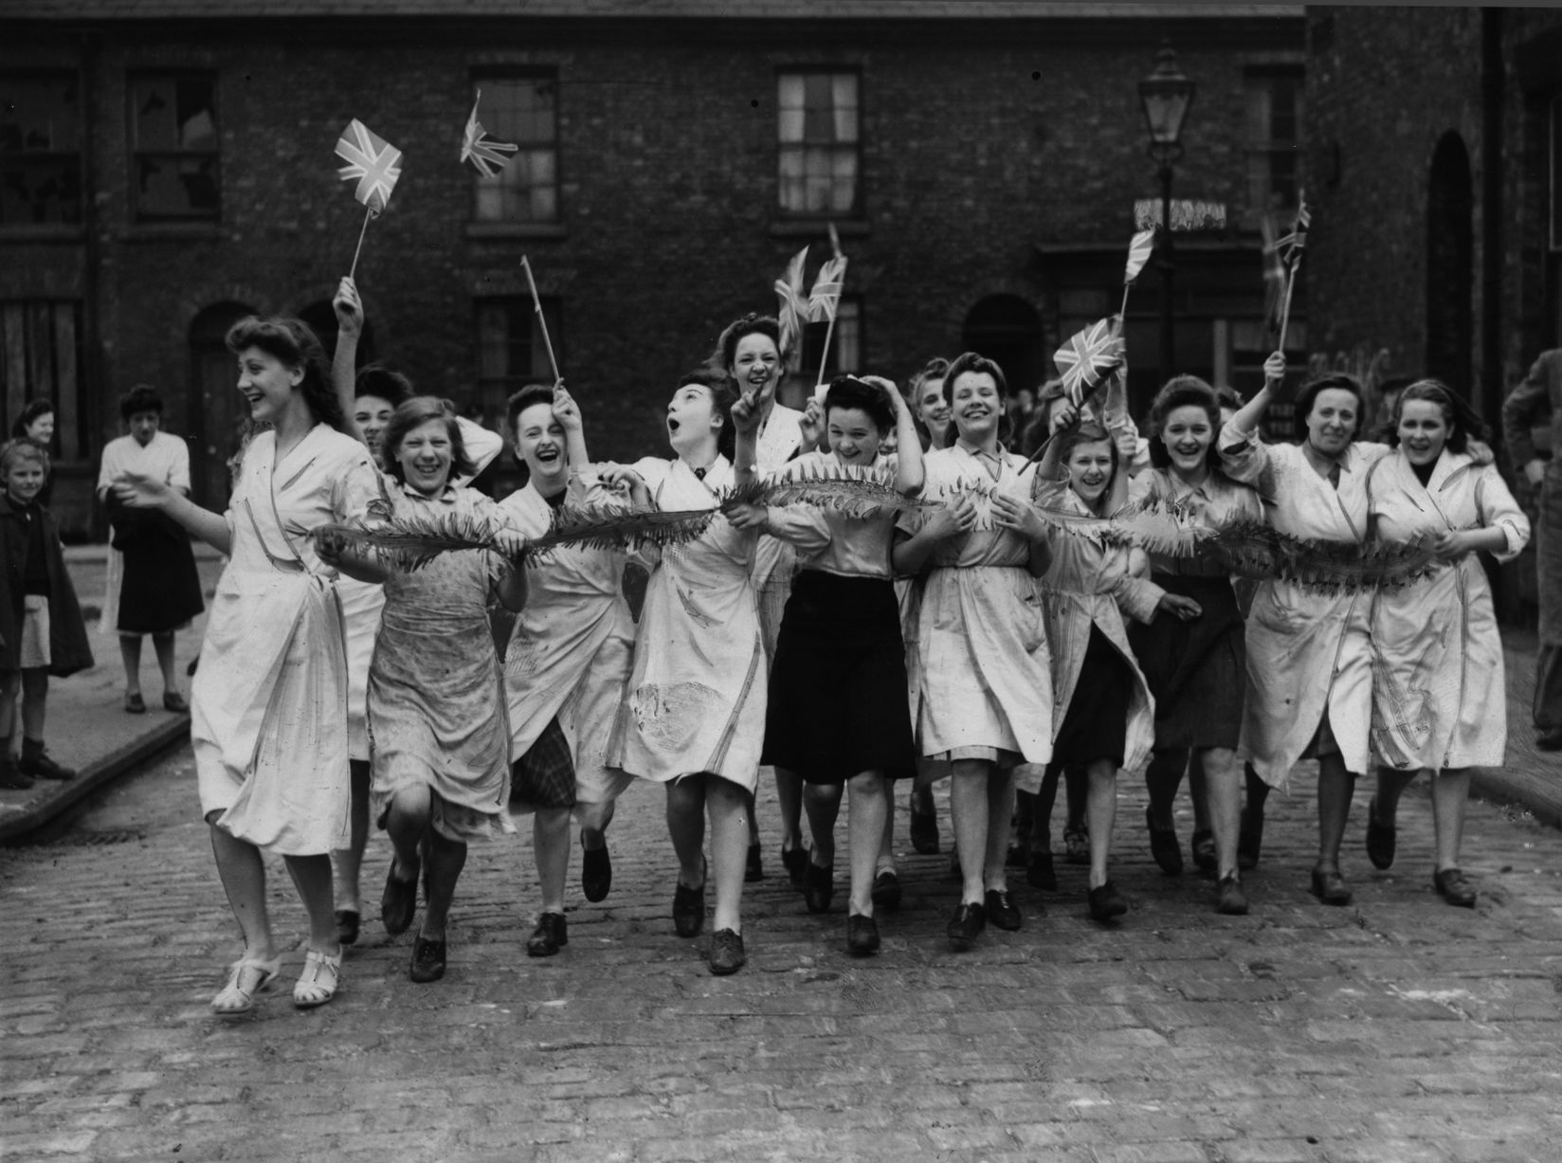
EXPRESS IT…
Write a VE Day celebration poem
HOME
Find out more…

Slide 14
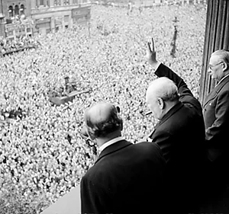
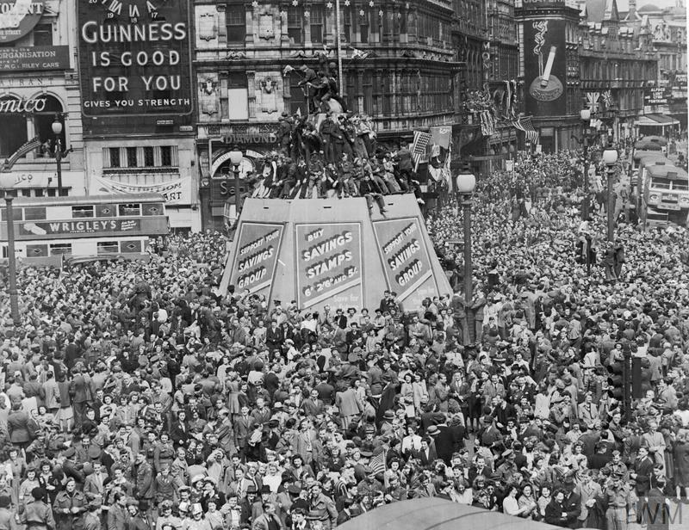
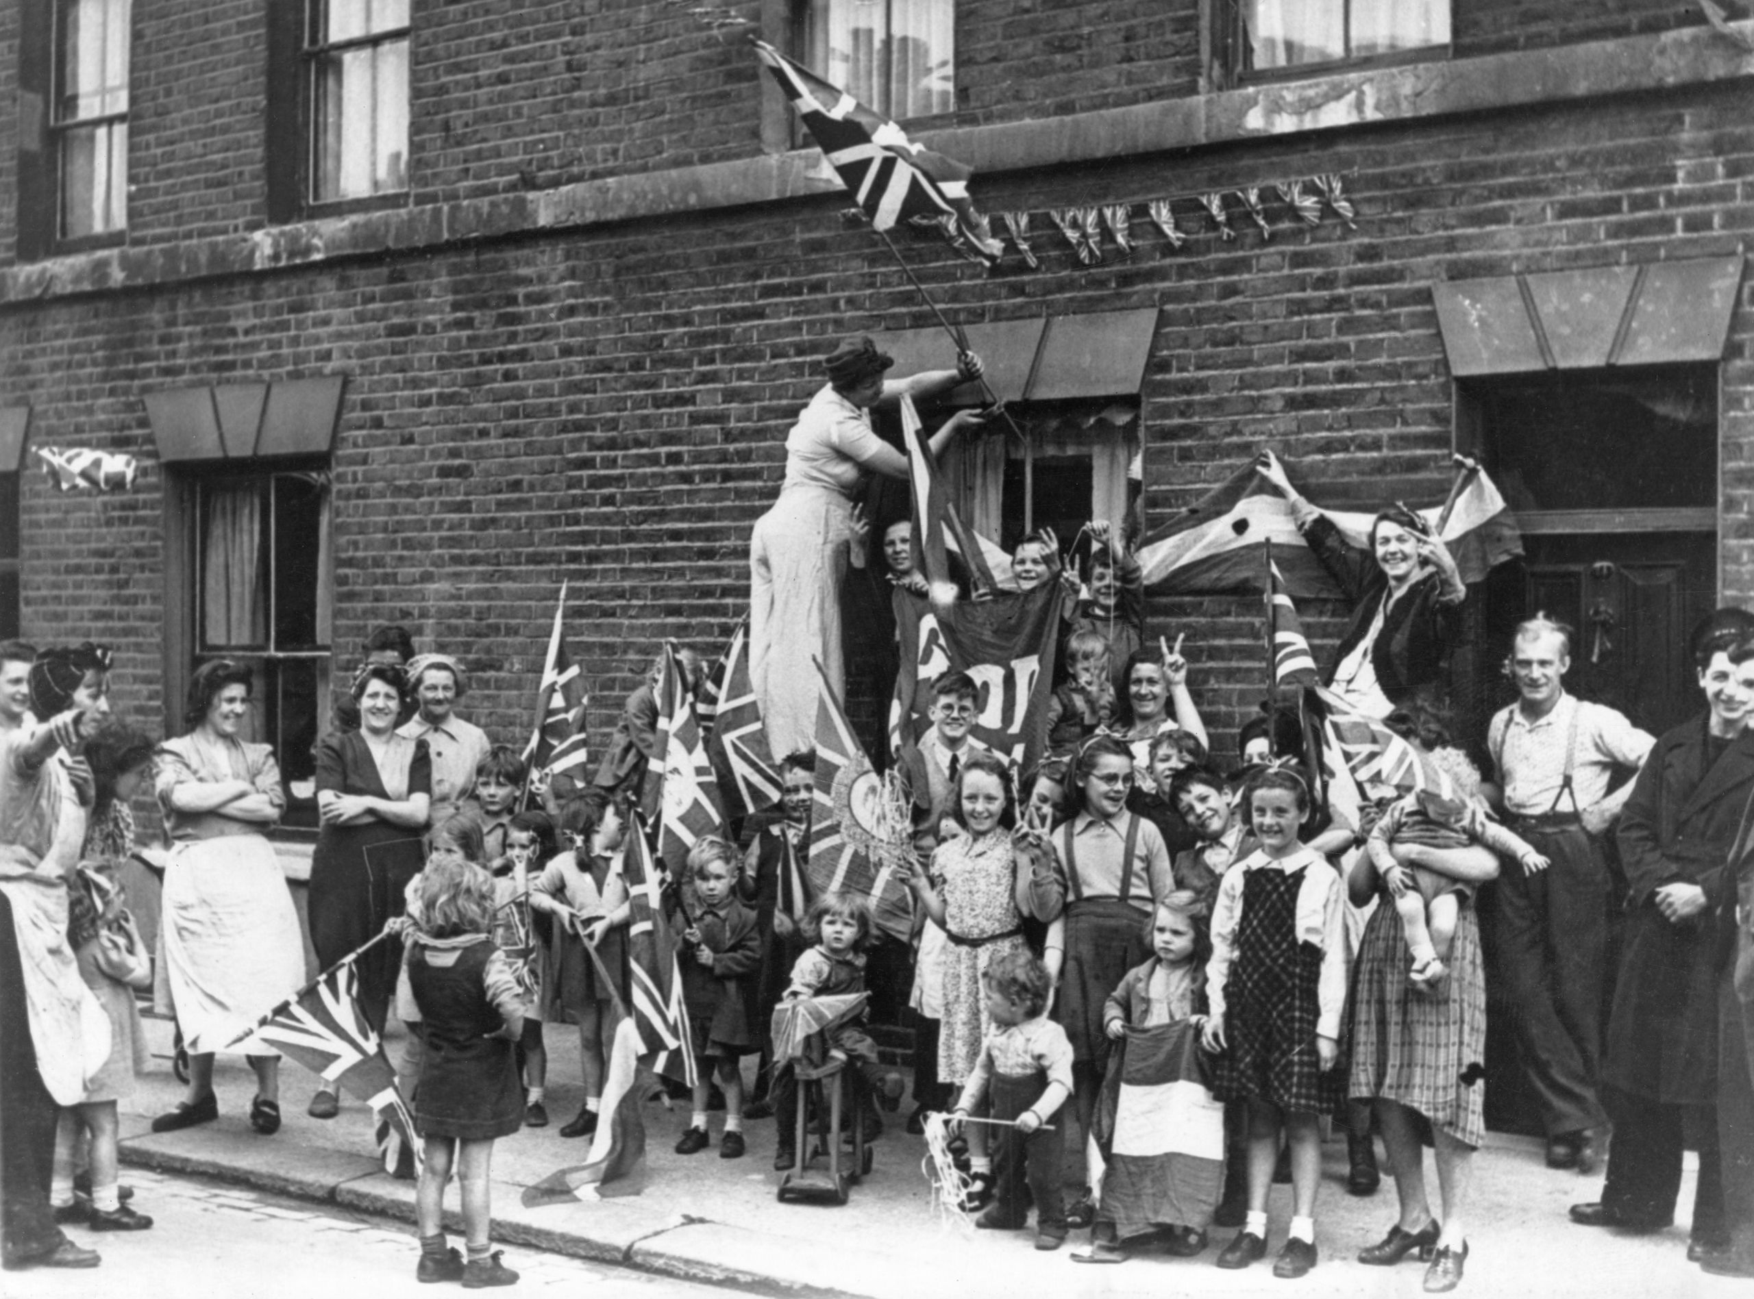
WRITE IT…
Write a VE Day Acrostic Poem
Use the words
VICTORY IN EUROPE DAY
to create an ACROSTIC poem which
reflects the mood of the celebration on
VE day in 1945, and illustrate it with
colourful images.
HOME

Slide 15
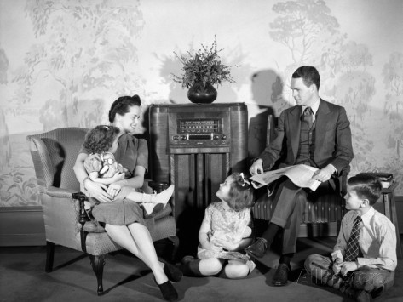
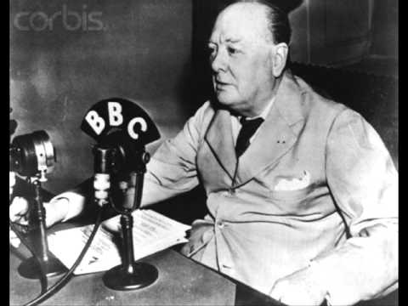
COMMUNICATE IT…
Write and record a radio broadcast for VE Day
Watch the VE Day video on the VE Day webpage of the school learning website.
Write a short radio broadcast and record it using Audacity or another recording app.
HOME

Slide 16
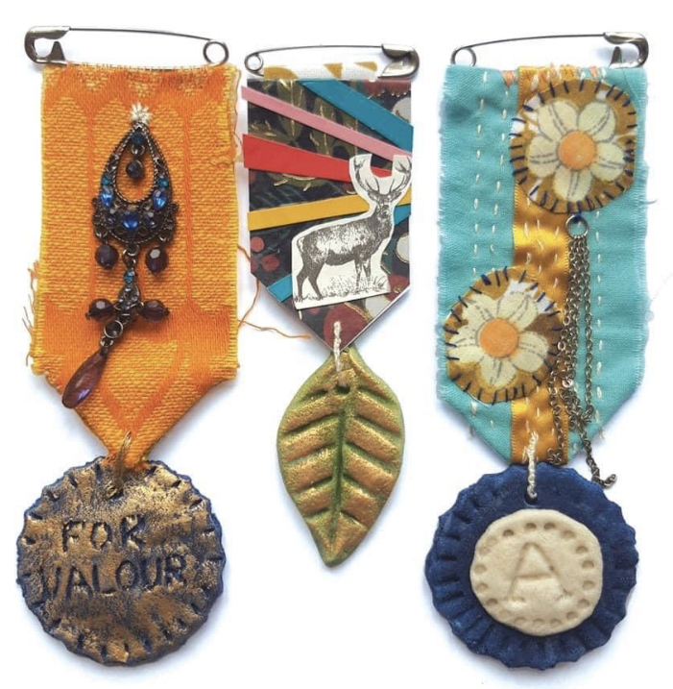
CREATE IT…
Design and create a medal
Create a medal using a range of materials you might have at home. Sew or glue the parts together.
Here are some ideas for things you could use:
Safety pin
Odd earrings
Buttons
Saltdough/clay shapes
Ribbon
Foam
Card/paper/cardboard
Bits of fabric
You can also create a medal online:
http://apps.mylearning.org/ww1medals/create-a-medal
HOME

Slide 17
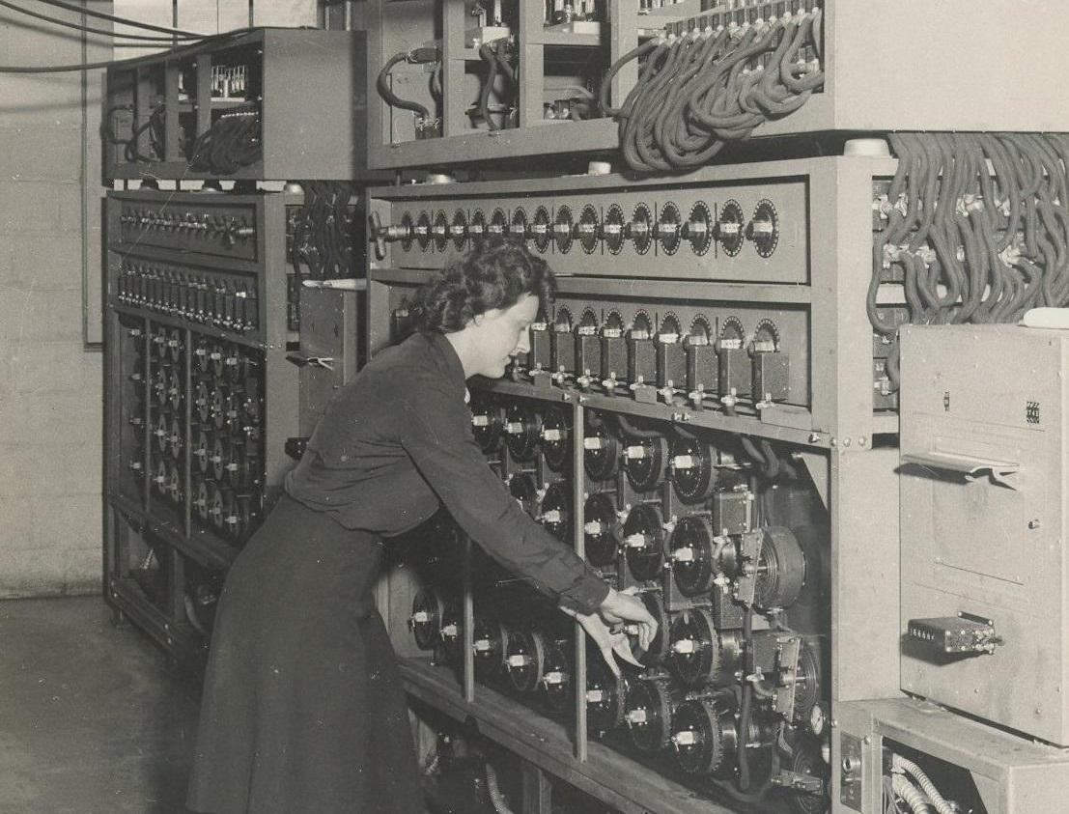
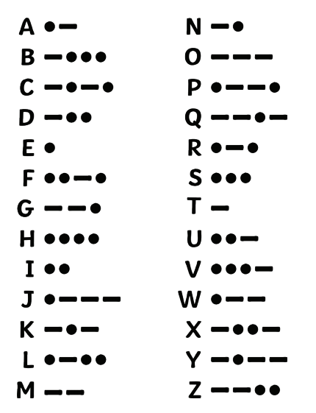
SOLVE IT…
Can you solve the Codebreaker Puzzles?
Images, symbols, codes, and ciphers have been used to communicate information secretly for thousands of years. Complete the Codebreaker Puzzles on the VE Day page.
Morse Code is a system of electronic communication. It uses dots, dashes, and
spaces to represent letters, punctuation, and numbers. The symbols are arranged to
spell out a message. A machine called a telegraph converts the symbols into electrical signals and sends them across a wire to their destination. The signals are then converted back into the message by the telegraph that receives them.
A U.S. artist and inventor named Samuel F.B. Morse created Morse Code in the 1830s. Morse Code and the telegraph allowed people to receive information sent from far away in just minutes. A second type of Morse Code was created in Europe in 1851. It was called the International Morse Code, or the Continental Morse Code. It has been used to base secret messages on in WW2 and there were top
secret places around the UK where codes and messages were investigated and
solved.
HOME

Slide 18
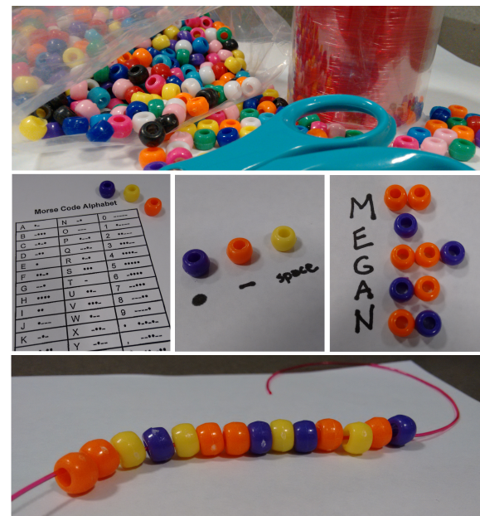
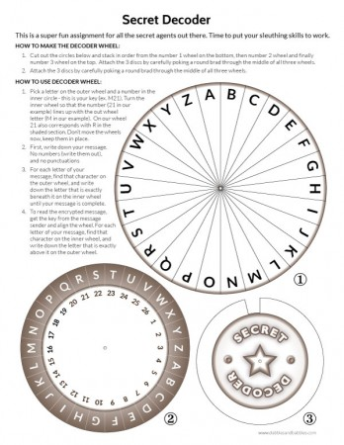
CODE IT…
Make Codebreakers
Morse
Code
Bracelet
Make a Secret Decoder.
Devise your own code and write some messages.
Materials:
Beads, assorted colors
String
Scissors
Morse Code Translator – see the Solve It sheet for the code.
Instructions:
Choose 3 different colors of beads.
Use the Morse Code Translator to create the letters in your name using 2 of the colors. Color #1 will represent the dots and Color #2 will represent the dashes.
Insert a bead of Color #3 in between each letter. This color will serve as a space.
String the beads to create a necklace or bracelet.
HOME

Slide 19
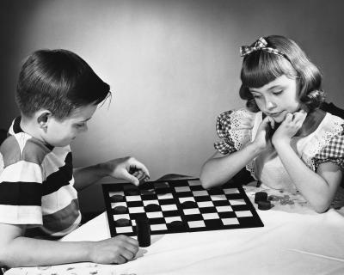
PLAY IT…
Learn to play Draughts or Backgammon
During WW2, children played many different games, both in groups and individually. Children commonly played Hopscotch, Four Square, Jump Rope, Chess etc. together, as well as all types of ball games. Young children loved to play jacks, marbles, play school and house, and played with cars or dolls. Kids in the neighbourhood loved playing games out on the street such as, "Red, Light, Green, Light", "Red Rover", "Hide and Seek", "Statutes" and many other games.
Board games were popular like Monopoly, Scrabble, Life, Checkers, Chess, Backgammon, Chinese Checkers, and Dominoes. Cards were a really big hit too. Children played for hours because they did not have video games or television. More often than not they made up their own games too.
HOME

