Slide 1
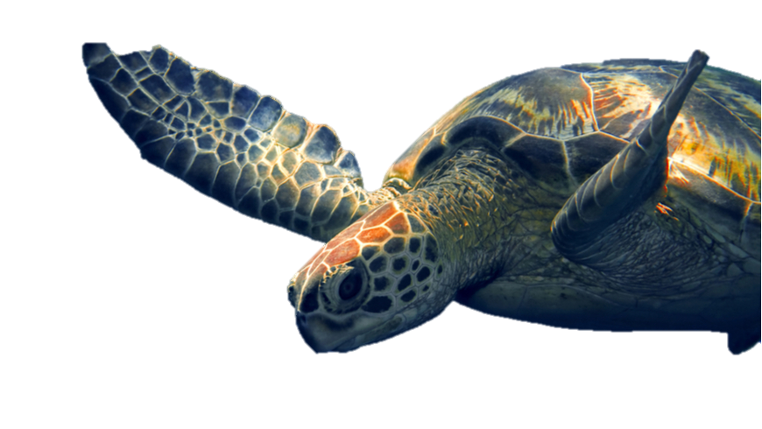
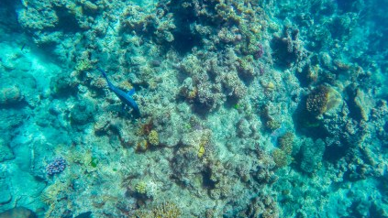
WORLD OCEANS DAY 2020
SEA TURTLES

Slide 2
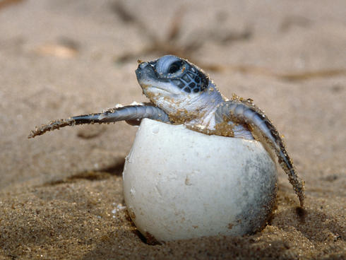
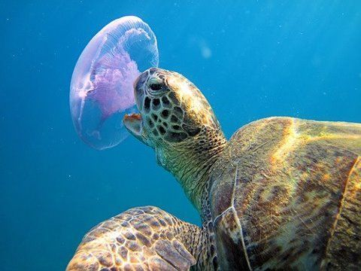
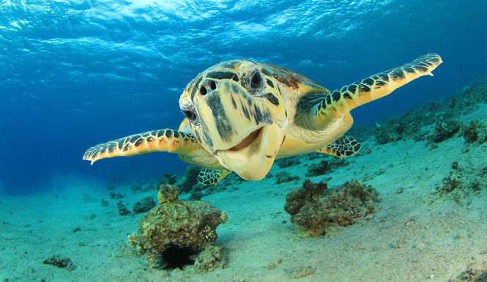
Interesting Facts about Turtles
Turtles can live a long time – some of them are 200 years old !!
Turtles lay eggs in the middle of the night on a sandy beach and swim 100s of miles to return to the beach where they were born each year to lay more eggs.
Turtles have a hard shell that protects their body. This hard shell is called a ‘carapace’.
Many Turtles can hide inside their shells if they think they are in danger.
Some Turtles eat jellyfish and squid, whilst others eat seaweed and algae.
Turtles are an endangered species !!

Slide 3
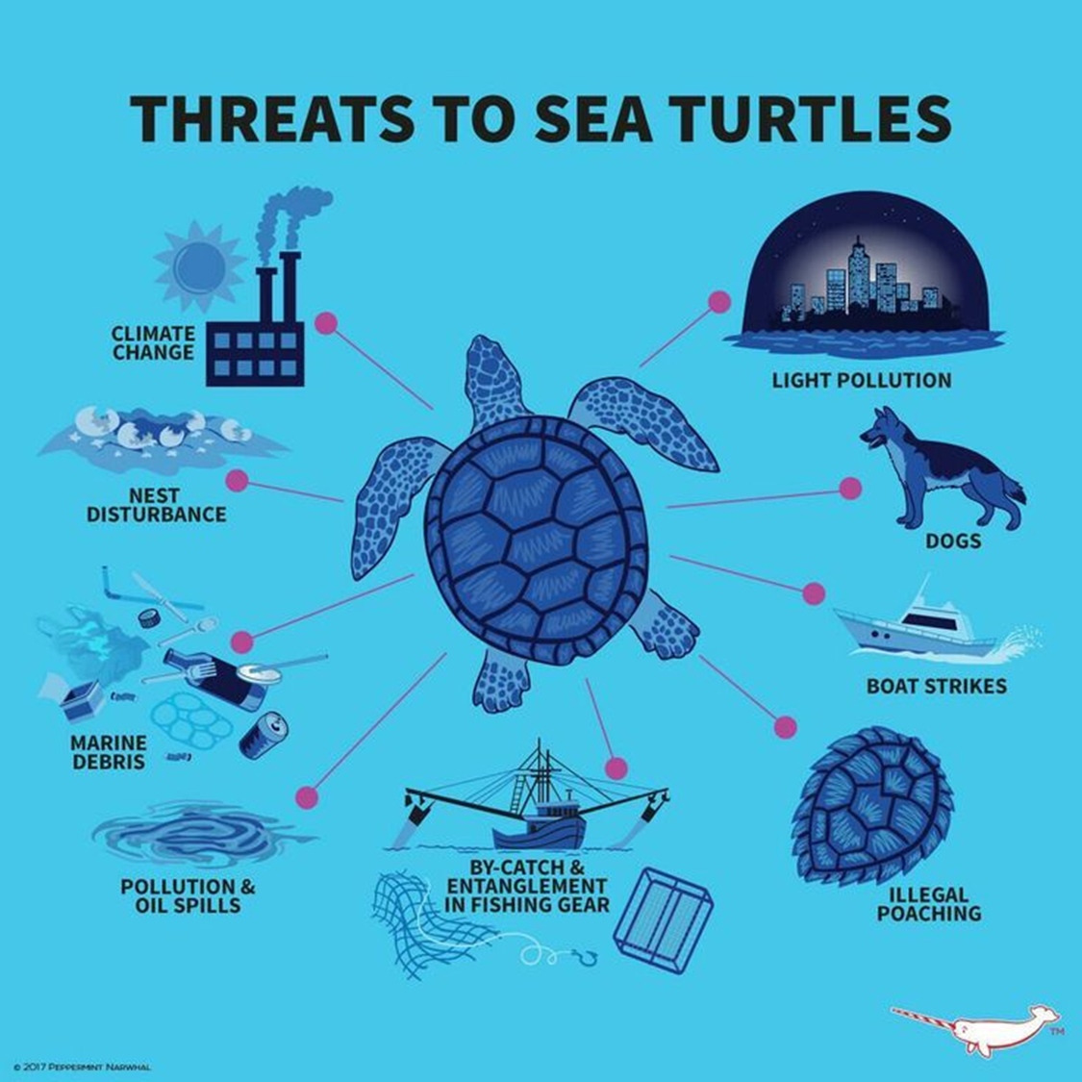
Sea Turtles are ENDANGERED
This means that they are in danger of becoming extinct !
(disappearing forever ! )
People cause many threats to
Sea Turtles

Slide 4
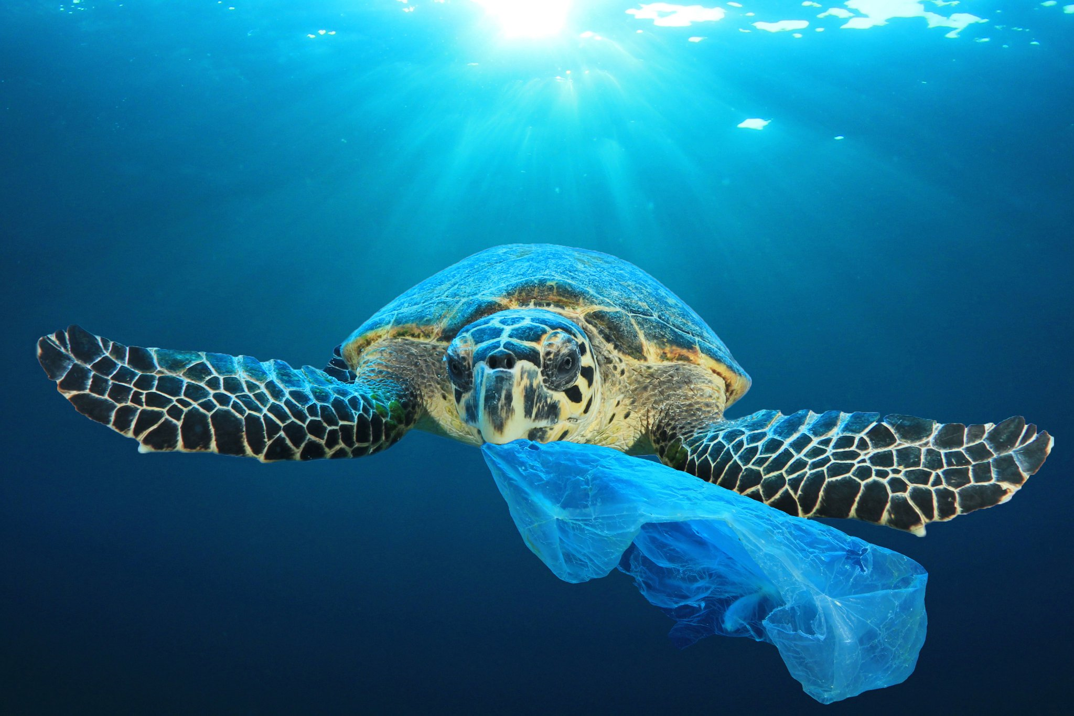
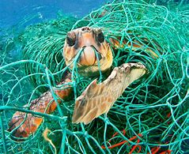
One of the biggest threats to Turtles is pollution.
Turtles see plastic in the ocean and think it might be jellyfish or other things they love to eat !!
What can we do to help and stop this happening ?
We can tell everyone to stop polluting our Oceans
We can tell everyone how special Turtles are !

Slide 5
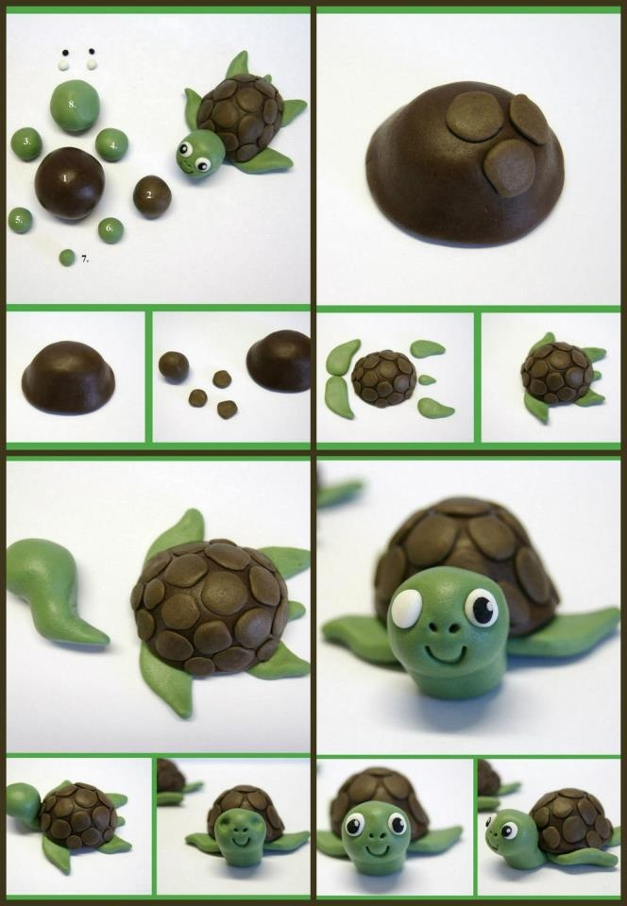
Create a Salt Dough Turtle
Salt Dough Recipe
1 cupful of plain flour (about 250g)
Half a cupful of table salt (about 125g)
Half a cupful of water (about 125ml)
This makes a snowball size piece – so double or triple the quantities if you need more !
Your Salt Dough Turtles can be baked in the oven or in a microwave.

Slide 6
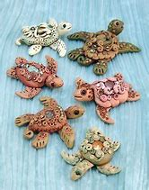
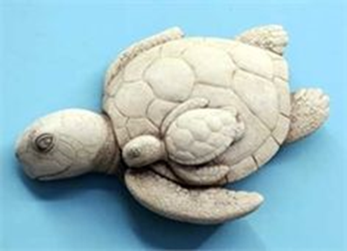
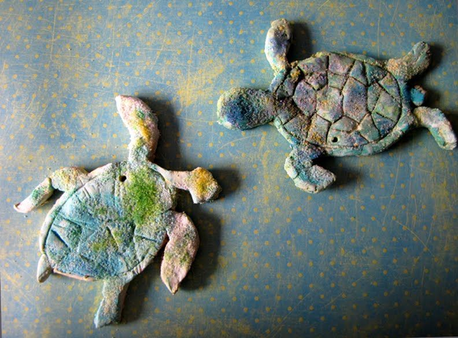
Create a Salt Dough Turtle
When you have baked your Salt Dough Turtle and it has cooled, you can paint it or colour it with pens (sharpies are good )
If you have an old fridge magnet ask an Adult to use some strong glue, and stick your Turtle on to it and then you can pop it on your fridge or a metallic surface.
Remember to take some pictures of your wonderful Turtles and send them to us.

